Slide 1
POLLUTION EFFECTS ON REPRODUCTION IN
REPTILES, BIRDS, FISH AND MARINE ANIMALS
GROUP 21

Slide 2
OUTLINE
INTRODUCTION
GENERAL OVERVIEW
POLLUTION EFFECT ON REPRODUCTION IN REPTILES
POLLUTION EFFECT ON REPRODUCTION IN BIRDS
POLLUTION EFFECT ON REPRODUCTION IN FISH
POLLUTION EFFECT ON REPRODUCTION IN MARINE ANIMAL
CONCLUSION
REFERENCES

Slide 3
INTRODUCTION
Pollution is the introduction of harmful substances into the environment. Examples of these pollutants or harmful substances include; plastics, heavy metals, noise, oil spills among others.
Pollution is a global issue that poses significant threat to the environment
and wildlife. Among the affected species, reptiles, birds, fishes and marine
animals face severe consequences as regards their reproductive abilities due to pollution.

Slide 4
GENERAL OVERVIEW OF POLLUTION EFFECTS ON REPRODUCTION IN REPTILES, BIRDS, FISHES AND MARINE ANIMALS
Reduced fertility: Exposure to pollutants, especially endocrine-disrupting chemicals (EDCs), can interfere with the hormonal systems of the organisms.
Egg viability: Pollution, especially environmental contaminants like heavy metals, can accumulate in the environment and contaminate the nesting sites of reptiles.
Accumulation of toxic substances: These organisms may ingest pollutants directly or indirectly through contamination food sources.

Slide 5
Hatchling survival: some pollutants can accumulate in the organism tissues and be transferred to developing embryos, potentially leading to reduced hatchling survival rates.
Impaird courtship and mating behavior: Pollution can affect the behavoir and physiology of these organisms, including their courtship and mating rituals.
Shifts in breeding timing and migration: Climate change, which is closely linked to pollution, can influence the timing of key events in these organisms life cycle.

Slide 6
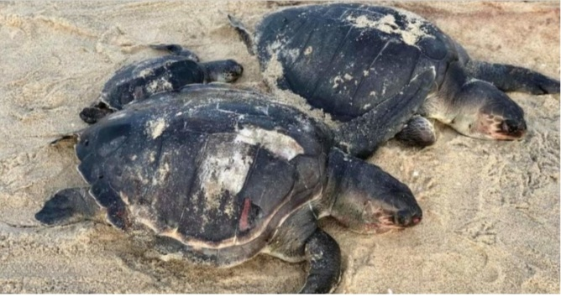
EXAMPLES SHOWING POLLUTION EFFECT ON REPRODUCTION IN SOME REPTILES
TURTLES
In the year 2000, a large crude oil spill from Sun Oil at the Refuge occurred. PAHs were subsequently detected in fat biopsies of turtles living in this area. This resulted in poor hatching success, the appearance of deformities and a decrease in survival rate in their young ones.

Slide 7
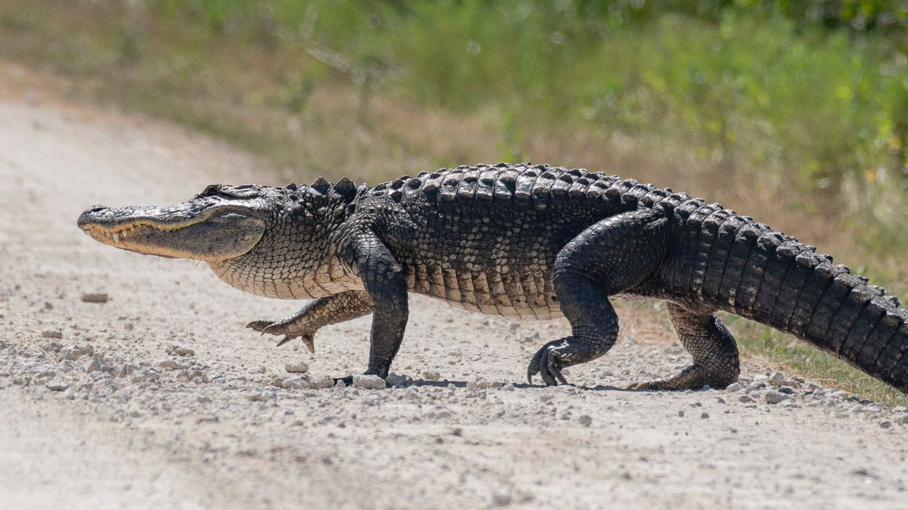
ALLIGATORS
Juvenile A. mississippiensis, alligators living in a lake in the state of Florida(USA), which is known to be polluted were found to exhibit reduced phallus size and lower plasma concentrations to testosterone than those of alligators of similar size, living in low polluted areas.

Slide 8
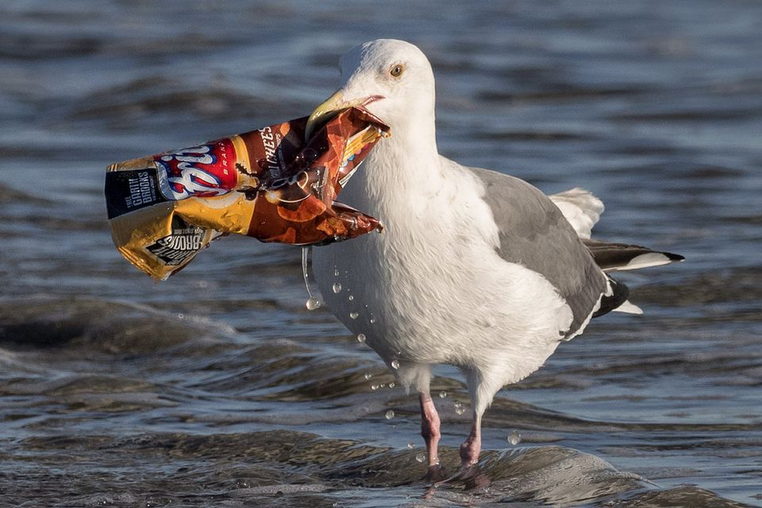
POLLUTION EFFECT ON REPRODUCTION IN BIRDS
In the case of birds, a study at the species level showed that birds with low frequency birdsongs were negatively affected by noise pollution than with higher frequency vocal. (Masayuki, et al. November 11,2020)

Slide 9
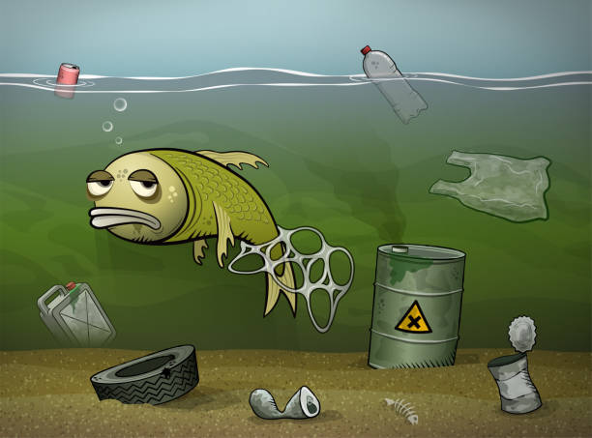
POLLUTION EFFECTS ON REPRODUCTION IN FISHES
Bioaccumulation and biomagnification
Behavioral changes
Egg and larval development

Slide 10
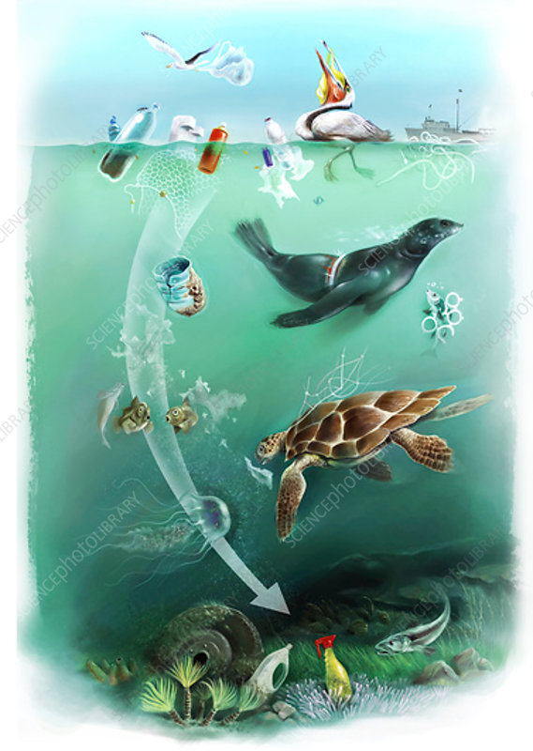
POLLUTION EFFECTS ON REPRODUCTION IN MARINE ANIMALS
Coral reef bleaching
Endocrine disruption
Plastic pollution

Slide 11
CONCLUSION
Pollution poses a severe threat on the reproductive abilities
of various organisms and so, it is advisable for the
government and agencies to address the impacts it has on
these organisms to combat pollution and protect these
vulnerable animal groups, thereby ensuring the crucial
safeguarding of biodiversity and ecosystem health.

Slide 12
REFERENCES
Gibbon JW, Scott DE, Ryan TJ, Buhmann KA, Tuberville TD, Metts BS, Greene JL, Mills T, Leiden Y, Poppy S, Winne CT. 2000. The global decline of reptile, deja vu amphibian. BioScience 50 : 653-6
Bell B, Spotila JR, Congdon J. 2006. High incidence of deformity in aquatic turtles in the John Heinz National Wildlife Refuge. Environ Pollut 142: 457– 465.
Candolin U, Wong BBM. 2012 Sexual selection in changing environments: consequences for individuals and populations. In Behavioural responses to a changing world: mechanisms and consequences (eds Candolin U, Wong BBM), pp. 201-215. Oxford, UK: Oxford University Press.

Slide 13
REFERENCES
Wingfield JC. 2015 Coping with change: a framework for environmental signals and how neuroendocrine pathways might respond. Front. Neuroendocrinol. 37, 89-96.
Guillette et al.,1999; Guillette and Guillette, 1996.

Slide 14
THANK YOU

Slide 15
GROUP MEMBERS
ADU ABENA OWUSU - 9196019
SMITH HENRY NII ARYEETEY - 9219219
RANDY OWUSU ADANSI - 9216819
ADJEI PETRA - 9195619
AFFENYI-BANSAH PRISCILLA - 9196419
ASIEDU PRECIOUS - 9202819
ABUBAKAR MUSAH - 9193819

